Slide 1
Flight Delay Prediction
By Natalie, Teagan, Benny
https://github.com/bgrullon/FlightDelayPrediction

Slide 2

Agenda
01
Team Introduction
02
The Topic and Questions
03
Data Sourcing, EDA, and ETL
04
Analysis and Visualizations
05
Conclusion and Prediction

Slide 3
Introduction
Talker

Slide 4
Topics & Questions
Talker

Slide 5
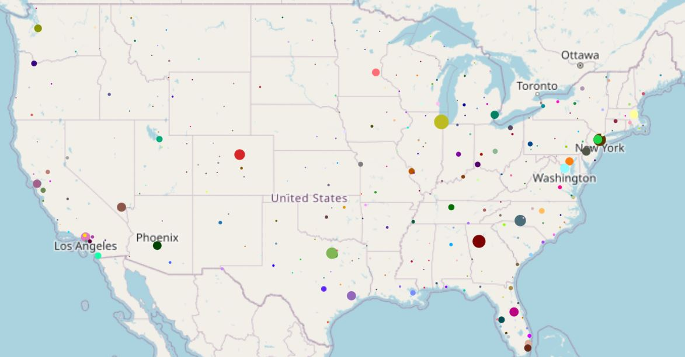


Flight Delays in the US
Size is based on sum of delays for the 3 days.

Slide 6
Data ETL & EDA
Talker

Slide 7
Flight and Weather Data
Flight Data for 3 Days | Flight Date | Arrival Airport | Departure Airport | Arrival Time | Departure Time | Delay
 | 2018-07-20 | ATL | LAX | 0900 | 0500 | -15.0
 | 2018-07-23 | BOS | DAL | 1545 | 1120 | -35.0
 | 2018-07-24 | AUS | BWI | 1830 | 1345 | -12.0
Weather Data for 3 Days | Time | Temperature (F) | Precipitation | Windspeed | Dew Point | City
 | 0900 | 44 | 0.01 | 6.3 | 73.5 | Albuquerque, New Mexico
 | 1300 | 58 | 0.0 | 10.1 | 66.3 | Dallas, Texas
 | 1700 | 70 | 0.03 | 7.1 | 56.6 | Denver, Colorado
Airline Data
Weather Data
Data from 2009 till 2018 was found on Kaggle and imported as a CSV via Kaggle’s API.
Historical Data was retrieved from Visual Crossings API.

Slide 8
Delays vs Windspeed
Teagan

Slide 9
Flight Delays Vs Windspeed
Analysis

Slide 10
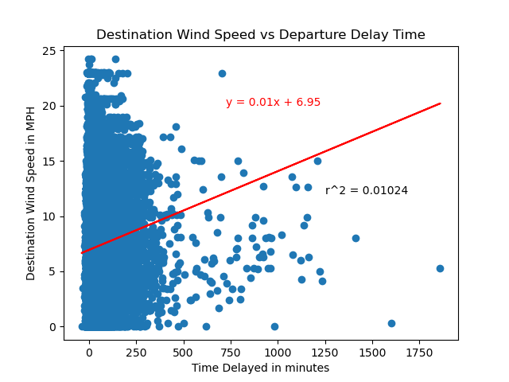

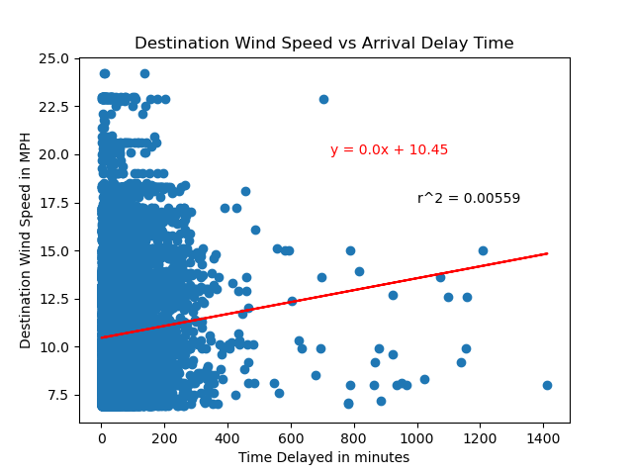

Flight Delay vs Windspeed

Slide 11
Delays vs Precipitation
Natalie

Slide 12
Flight Delays Vs Precipitation
Analysis
Correlation Coefficient
0.06 Arrival Delay
0.05 Departure Delay
R-squared Value
~0.0042 Arrival Delay
~0.0026 Departure Delay
Airport with Most/Least Precipitation
Most: ATL at 1.151 inches
Least: AUS at 0.0 inches

Slide 13
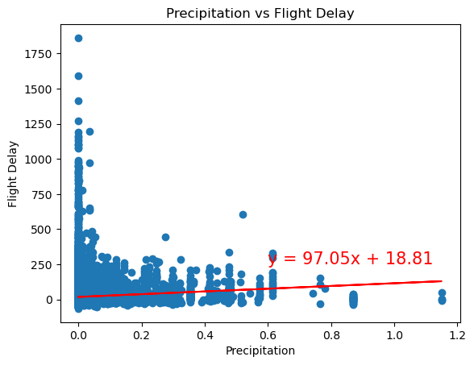
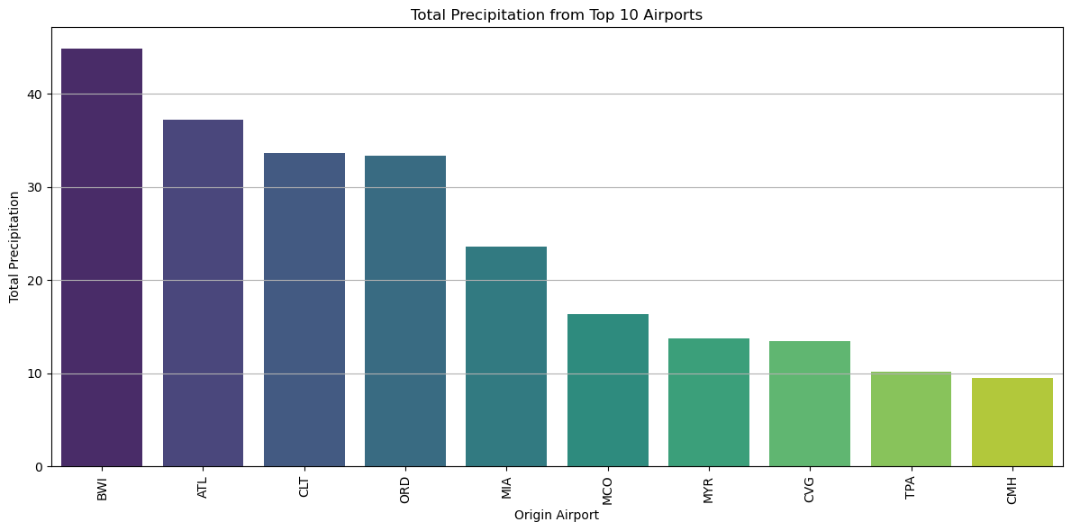
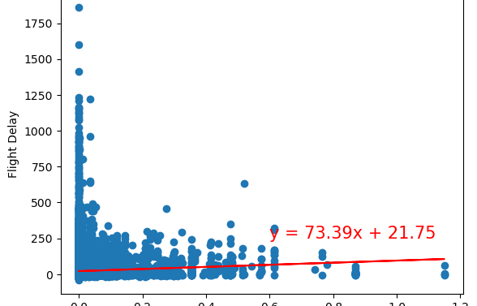
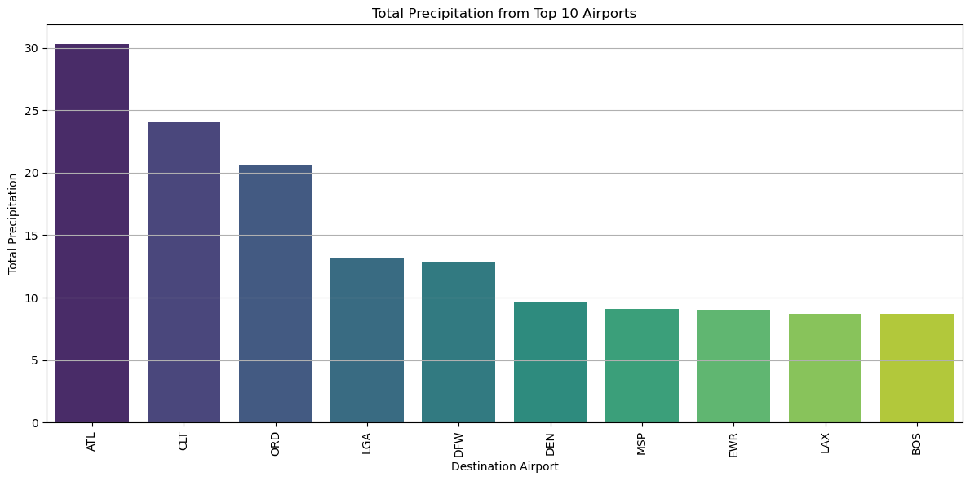

Precipitation Visualizations
You can simply impress your audience and add a unique zing and appeal to your Presentations. Easy to change colors, photos and Text. Get a modern PowerPoint Presentation that is beautifully designed. You can simply impress your audience and add a unique zing and appeal to your Presentations.

Slide 14
Delays vs Temperature
Benny

Slide 15
Flight Delays Vs Temperature
Analysis

Slide 16
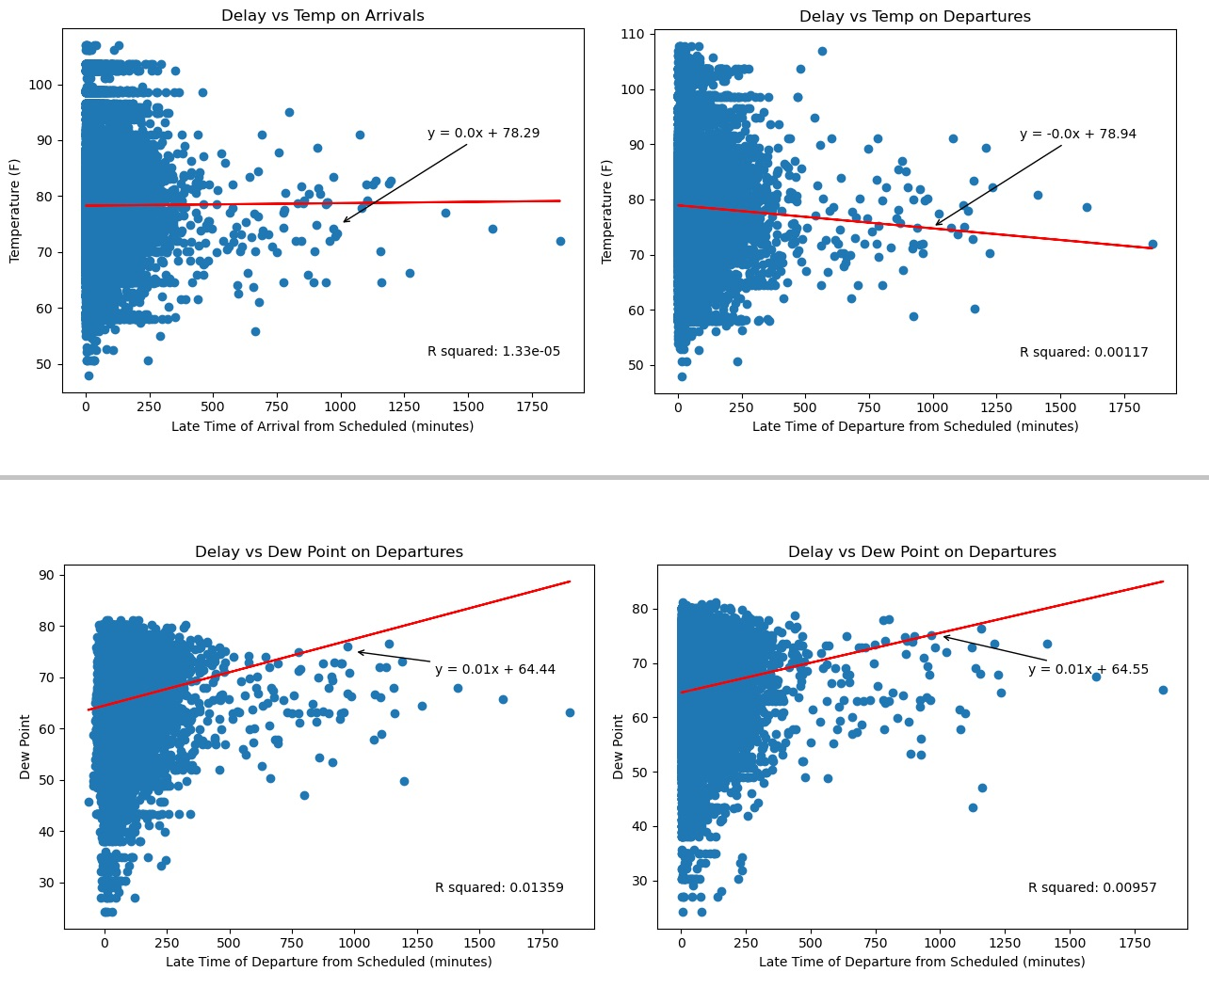
Flight Delay vs Temperature
Correlation
Temperature
Departure Delay is -0.03
Arrival Delay is -0.01
Dew Point Temperature
Departure Delay is 0.1
Arrival Delay is 0.1

Slide 17
Prediction
Benny

Slide 18
Thank you

